Slide 1
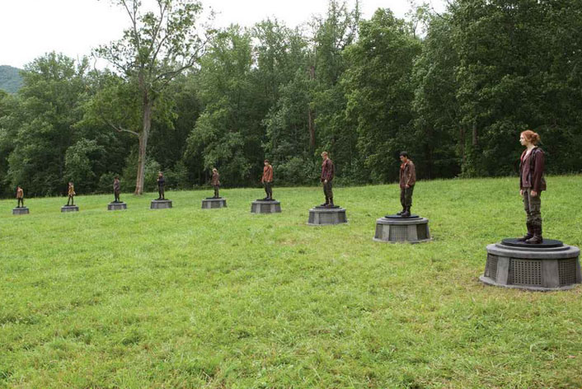
‘Human Nature in The Hunger Games’
Starter: If you were A Tribute, stood on the podium, surrounded by 23 other tributes, about to start to Hunger Game, how would you be feeling? “As a Tribute, I would be feeling….” [list as many things as you can in your books]
Challenge: When the games begin, would you run into the centre to get the supplies or would you run away?

Slide 2
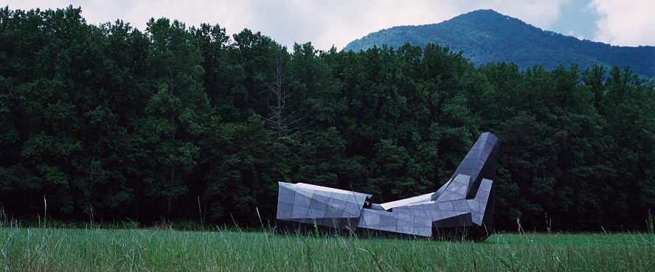
Learning Objectives
To examine how tension is created through sentence structure
To explore the theme of human nature
To continue reading the novel

Slide 3

Echoes. Everything I did rebounded off the wall back to my ears, giving the illusion that there were ghosts of the previous tributes haunting the launch room. I shuffled nervously. It wouldn’t be long until I was fighting for my life and I couldn’t be more scared. Slowly, I made my way to the launch pad at the command of the tinny voice which burst into the room. It was time to face the games.
How effective is this opening at creating tension? Discuss in your groups.
Extension Task – Can you think of any ways that you might improve the paragraph to build more tension?

Slide 4
Learning Question: What do the first moments in the arena show us about Human Nature?
We are told “Already other tributes […] are spreading out to attack”? What’s the most significant word here? Why?
Look again at the words Collins uses to describe the girl from district 2; which is the most interesting do you think? Why?
What’s interesting about Katniss’s reaction to the blade being thrown? What might this imply about her? How does this contrast with the initial response she has towards the violence?
Why does Collins use the word ‘hacking’? What technique is being applied here? What impact does it have on the reader? Why?
Pages 174 and 175
Notes:
Discuss with partner.

Slide 5
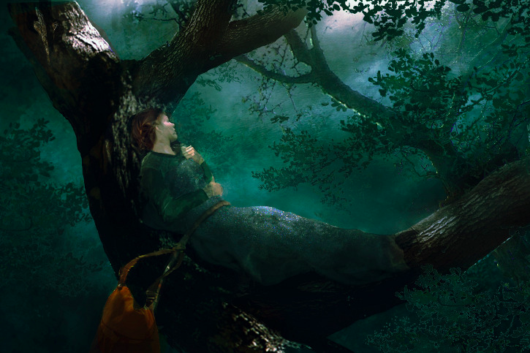
Chapter 12

Slide 6
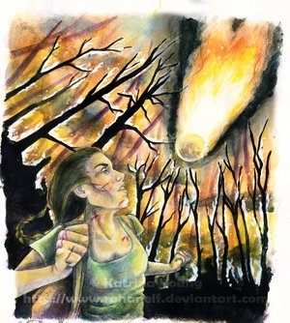
Summary
Starter: Sum up the reading you completed for homework in 27 words exactly.

Slide 7


Chapter 14. Page 216.
Notes:
7

Slide 8
Learning Question: How does Collins explore the theme of violence in the Hunger Games?
Question: Once Collins has established an emotional connection between Katniss and the reader, what technical skills does she use to sustain engagement?
__________ force the reader to read ______________. This suggests an impending ____________: something dramatic is about to happen. This works to increase ___________. It also allows the reader to __________ with the tension felt by the character (as they are experiencing the same emotions), further enhancing ____________, therefore .
“People have not exaggerated the effects of the tracker jacker stings. Actually, the one on my knee is closer to an orange than a plum in size. A foul-smelling green liquid oozes from the places where I pulled out the stingers.
The swelling. The pain. The ooze. Watching Glimmer twitching to death on the ground. It’s a lot to handle before the sun has even cleared the horizon. I don’t want to think about what Glimmer must look like now. Her body disfigured. Her swollen fingers stiffening around the bow.
The bow! Somewhere in my befuddled mind one thought connects to another and I’m on my feet, teetering through the trees back to Glimmer. The bow. The arrows. I must get them.” p. 223
suspense
faster
short sentences
empathise
climax
engagement
Challenge: How else can a writer create suspense?
Ellipses
Alliteration
First person perspective
High stakes

